Slide 1
"I was still a couple of miles above the clouds when it broke, and with such violence I fell to the ground that I found myself stunned, and in a hole nine fathoms under the grass, when I recovered, hardly knowing how to get out again. Looking down, I observed that I had on a pair of boots with exceptionally sturdy straps. Grasping them firmly, I pulled with all my might. Soon I had hoist myself to the top and stepped out on terra firma without further ado.“
- Baron Munchausen
(in Singular Travels, Campaigns and Adventures of Baron Munchausen, by R. E. Raspe, 1786.)

Slide 2
Introduction to Bootstrapping
Rik Chakraborti and Gavin Roberts

Slide 3
Sailing in the clouds
Statistical Inference (hypothesis testing, or creating confidence intervals) requires knowledge about the sampling distribution of the estimator &/or the sampling distribution of test statistics.
For example:
To test $H_{0}: β=0$ against${ H}_{A}: β≠0$
We use $\frac{b}{SE(b)}\sim t\left(n−k\right)$

Slide 4
Sailing in the clouds – idealized assumptions and asymptotics
But how do we get there?
Assume $ϵ \sim N\left(0, σ^{2}I\right)⟹b \sim N(β, σ^{2}{{(X}^{′}X)}^{−1})⟹\frac{b}{SE(b)}\sim t\left(n−k\right)$
But if errors are not normally distributed, and we don’t have a sample size large enough to justify invoking the CLT, what is the sampling distribution of $\frac{b}{SE(b)}$ ?

Slide 5
The cloud breaks…!
If we don’t know, should we assume normality?
GAUSS EXAMPLE
Shows empirical size of test is wrong when sample size is small under non-normal errors.
Sampling distribution of the “significance statistic” does not follow the usual $t(n−k)$ distribution.
If we still use t-table to test significance, we will make type – I errors.

Slide 6
And we fall, hard!
Previous example shows knowing the sampling distribution is important for valid inference. But, this may be difficult if –
Assumptions about the distribution of errors are false. Errors may not be distributed normally, or even asymptotically normally.
Computing sampling characteristics of certain statistics for finite sample sizes can be very difficult. Typically this is circumvented by resorting to asymptotic algebra. For example, for testing non-linear hypothesis when we use the delta method, we rely on asymptotic justification.

Slide 7
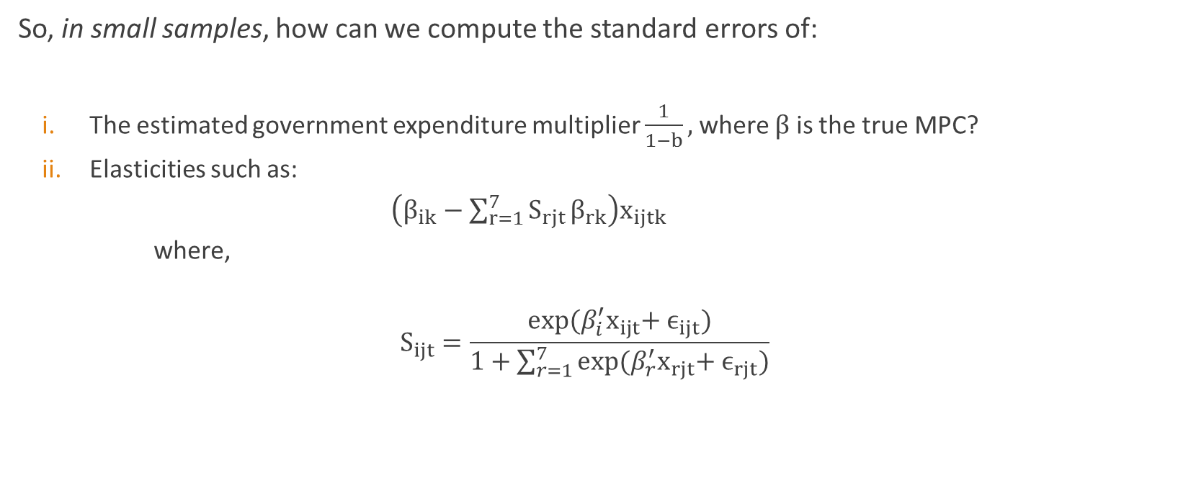
Stuck in a rut, 9 fathoms deep?
So, in small samples, how can we compute the standard errors of:
The estimated government expenditure multiplier $\frac{1}{1−b},$where $β$ is the true MPC?
Elasticities such as:
$\left(β_{ik}−\sum_{r=1}^{7}{S_{rjt}}β_{rk}\right)x_{ijtk}$
where,
$$S_{ijt}=\frac{exp⁡(β_{i}^{′}x_{ijt}+{ ϵ}_{ijt})}{1+\sum_{r=1}^{7}{{exp⁡(β}_{r}^{′}x_{rjt}+{ ϵ}_{rjt})}}$$

Slide 8
So, what do we do?
Basic problem – have no clue about small sample properties of sampling distribution of estimator/statistic of interest.
SOLUTION – GO MONTE CARLO?

Slide 9
Monte Carlo, with a difference!
Typically, we’ve run Monte-Carlo simulations in the context of simple regressions.
STEPS:
Simulate sample data using process that mimics true DGP.
Compute statistic of interest for sample.
Repeat for mind bogglingly large number of times as long as it doesn’t boggle the computer’s mind
- Generates sampling distribution of statistic of interest

Slide 10

Monte Carlo, with a difference!
Implementing in our case - $y_{i}=α+βx_{i}+ε_{i}$
Start off with initial sample:
$$\left[\begin{aligned}y_{1} \\ y_{2} \\ . \\ . \\ y_{n}\end{aligned}\right] and \left[\begin{aligned}x_{1} \\ x_{2} \\ . \\ . \\ x_{n}\end{aligned}\right]$$

Slide 11
Monte Carlo, with a difference (steps 2 and 3)
Run OLS, obtain estimates $a$ and $b$.
Then, generate new samples using these estimates:
$\left[\begin{aligned}y_{1}^{∗} \\ y_{2}^{∗} \\ . \\ . \\ y_{n}^{∗}\end{aligned}\right]=a\left[\begin{aligned}1 \\ 1 \\ . \\ . \\ 1\end{aligned}\right]+b\left[\begin{aligned}x_{1} \\ x_{2} \\ . \\ . \\ x_{n}\end{aligned}\right]$ $+ \left[\begin{aligned}? \\ ? \\ . \\ . \\ ?\end{aligned}\right]$

Slide 12
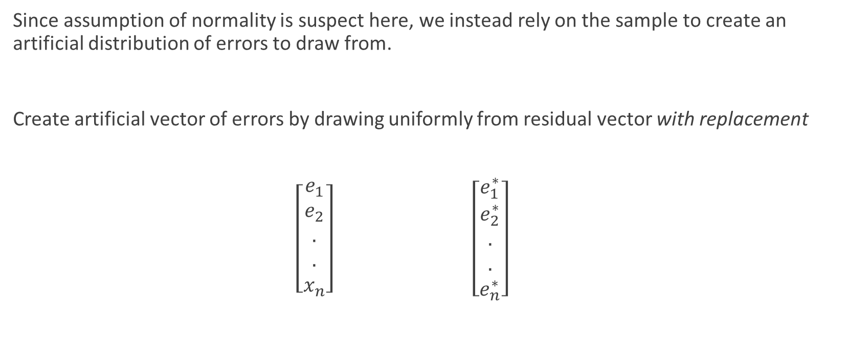
Here’s the difference
Since assumption of normality is suspect here, we instead rely on the sample to create an artificial distribution of errors to draw from.
Create artificial vector of errors by drawing uniformly from residual vector with replacement
$\left[\begin{aligned}e_{1} \\ e_{2} \\ . \\ . \\ x_{n}\end{aligned}\right]$ $\left[\begin{aligned}e_{1}^{∗} \\ e_{2}^{∗} \\ . \\ . \\ e_{n}^{∗}\end{aligned}\right]$

Slide 13
Procedure
So, generate new sample as:
$\left[\begin{aligned}y_{1}^{∗} \\ y_{2}^{∗} \\ . \\ . \\ y_{n}^{∗}\end{aligned}\right]=a\left[\begin{aligned}1 \\ 1 \\ . \\ . \\ 1\end{aligned}\right]+b\left[\begin{aligned}x_{1} \\ x_{2} \\ . \\ . \\ x_{n}\end{aligned}\right]+\left[\begin{aligned}e_{1}^{∗} \\ e_{2}^{∗} \\ . \\ . \\ e_{n}^{∗}\end{aligned}\right]$
Compute $b^{∗}$, repeat $B$ times - generates estimated sampling distribution of $b$.

Slide 14

Why does it work?
Consistency of $b→$consistency of $e$ as estimator of $ϵ$
Bootstrapped point estimate:
$b_{B}=\frac{1}{B}\sum_{r=1}^{B}{b_{r}^{∗}}$
$\hat{var}\left(b_{B}\right)=\frac{1}{B−1}\sum_{r=1}^{B}{{(b}_{r}^{∗}−}b_{B}$)${(b}_{r}^{∗}−b_{B}$)’
It can be shown that $b_{B}$ $b$
d

Slide 15
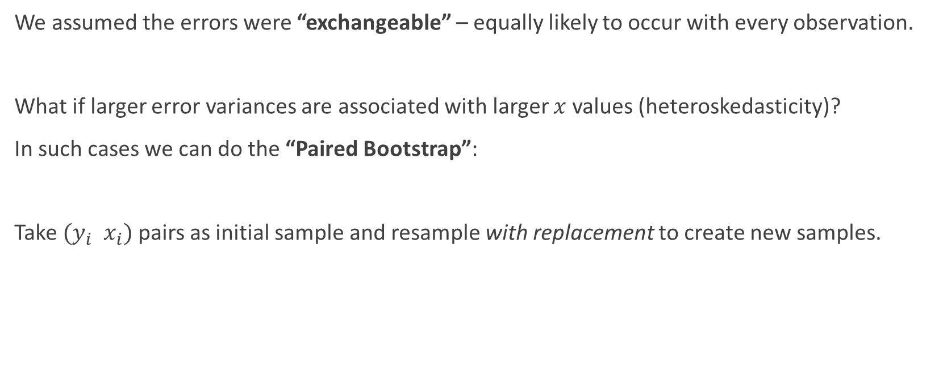
But…
We assumed the errors were “exchangeable” – equally likely to occur with every observation.
What if larger error variances are associated with larger $x$ values (heteroskedasticity)?
In such cases we can do the “Paired Bootstrap”:
Take $(y_{i}{ x}_{i})$ pairs as initial sample and resample with replacement to create new samples.

Slide 16
Advantages of the paired bootstrap
Keeps error paired with original explanatory variable it was associated with.
Implicitly employs true errors, true underlying parameters and preserves original functional form.
Allows explanatory variables to vary across samples – assumption of non-stochastic regressors relaxed.

Slide 17
Common uses
Estimation of standard errors when these are hard to compute
Figuring out proper size of tests, i.e., type – I error rates.
Bias correction.

Slide 18
Caution – check sturdiness of straps before the haul!
Bootstrapping performs better in estimating sampling distributions of “asymptotically pivotal” statistics – statistics whose sampling distribution does not depend on unknown population parameters.
– sampling distribution of parameter estimates typically depend on population parameters. Instead, bootstrapped sampling distribution of the t-statistic converges faster.

Slide 19
Further references for prospective bootstrappers
Kennedy – Chapter 4, section 6, if you want to understand the bootstrap
Cameron and Trivedi – Chapter 11, if you want to do the bootstrap
MacKinnon (2006) – Uses and abuses to be wary of.
And most importantly, Watch “The adventures of Baron Munchausen” the awesome Terry Gilliam movie.

